Slide 1


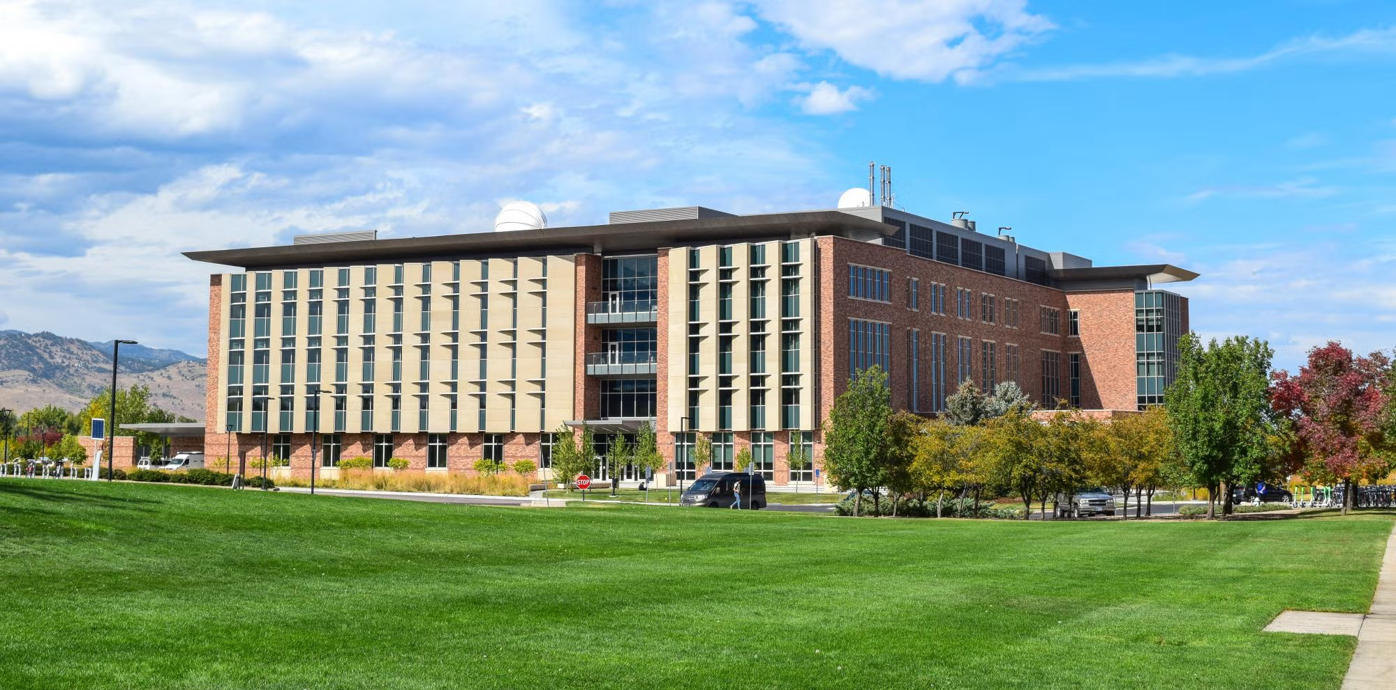
Quantum Annealers for LEO Satellite Constellation Optimization (I promise this will be cool, not just for Sergio)
Tommy Clark (updated Smead building below at Dan’s request)

Slide 2
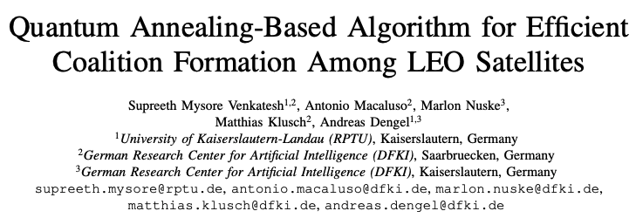
What the heck?
• AI is boring now… everyone does it. (kidding, sorta)
• I told Dan about this paper and he told me to it would be a good astroseminar.
• IDEA: There is a much better way to run optimization. (involving quantum computers)
• Caveat: You need to formulate your optimization problem in specific graph structure. (Always possible for discrete problems but may be some effort)

Slide 3
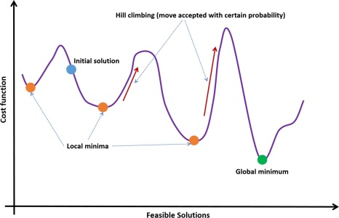
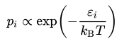
Annealing (The real one)
Thermodynamics: Systems go to equilibrium…
What if the equilibrium is over an energy barrier?
Need to provide an energy kick over the barrier. Typically wait for thermal fluctuations (heat).
Statistical Mechanics: telling you that over time you are most likely to end up at the global minimum.
HEAT
Boltzmann Distribution:

Slide 4
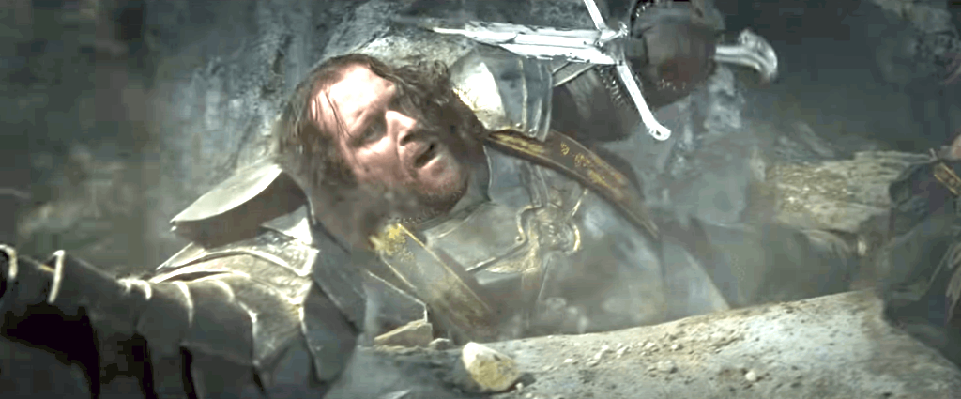
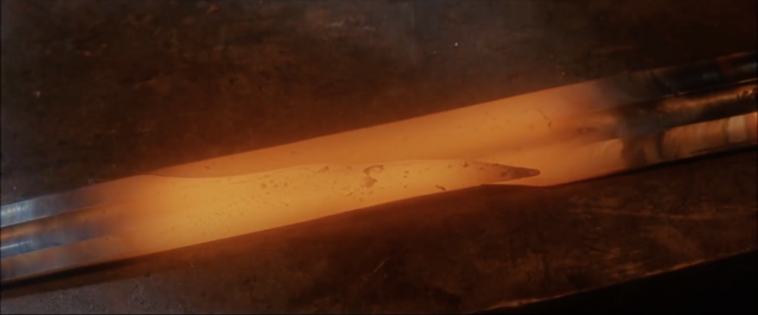

In the real world…
Sauron breaks your fragile sword.
Heat up the bent, broken, fragile metal.
Cool atoms slowly – atoms settle into very strong lattice – Global Minimum State
Improved (Elvish) Annealing

Slide 5
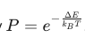
Simulated Annealing
You can (and might already) anneal too! (This is slower than Convex Optimization but is one of the better ways to find a global minimum for non-convex problems)
Metropolis Algorithm:
1. Start out with random trajectory for the solution.
2. Take a small step or perturbation onto new trajectory.
3a. If the new trajectory has a lower energy (cost) accept.
3b. If the new has a higher energy accept with probability
4. Reduce temperature by 5% or something small. Note it must decrease slowly… too fast = not enough chances to get out of local minima.

Slide 6

Graphics (stolen) are good
At first the high temperature makes it likely we hang around the global minimum and bounce out of local minima.
As the temperature decreases, it makes it harder and harder to leave global minimum.
Run a few times and you’ll find a pretty good solution.

Slide 7
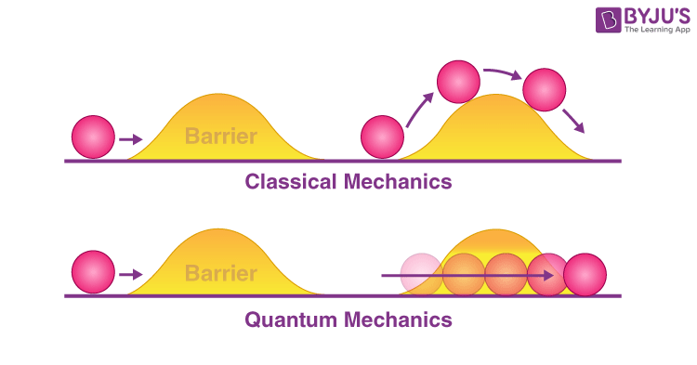
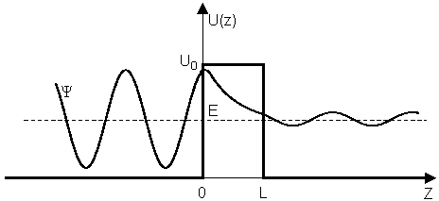
Quantum Annealing
Quantum Mechanics (the jist): A pretty ugly PDE that is not physically intuitive.
Fix the energy of the system. (No more time dependence)
Solve boundary value problem. (spatial PDE, easy)
WOAH – The solution has probability of being on both sides of barrier.
“Quantum Tunneling”
“Tunneling”:
“Physics”:
System Energy

Slide 8
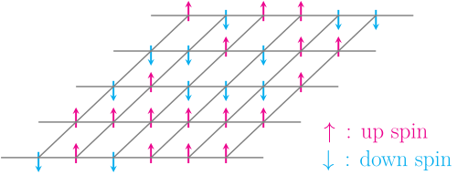
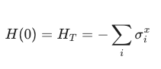
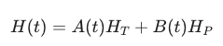
How we really do it…
Start with big array of spins. Apply transverse field.
Massive superposition – imagine a ball at every position on cost (like having 2^N balls!) .
H_T
3. Now turn down the transverse field and turn up your problem Hamiltonian (a specially designed magnetic field representing your cost function). The system sees all the states at first an tunnels into the global minimum.
Doesn’t need 100 years to get thermal kick into new solution region... Nanoseconds vs. 1000 years for complex problems

Slide 9
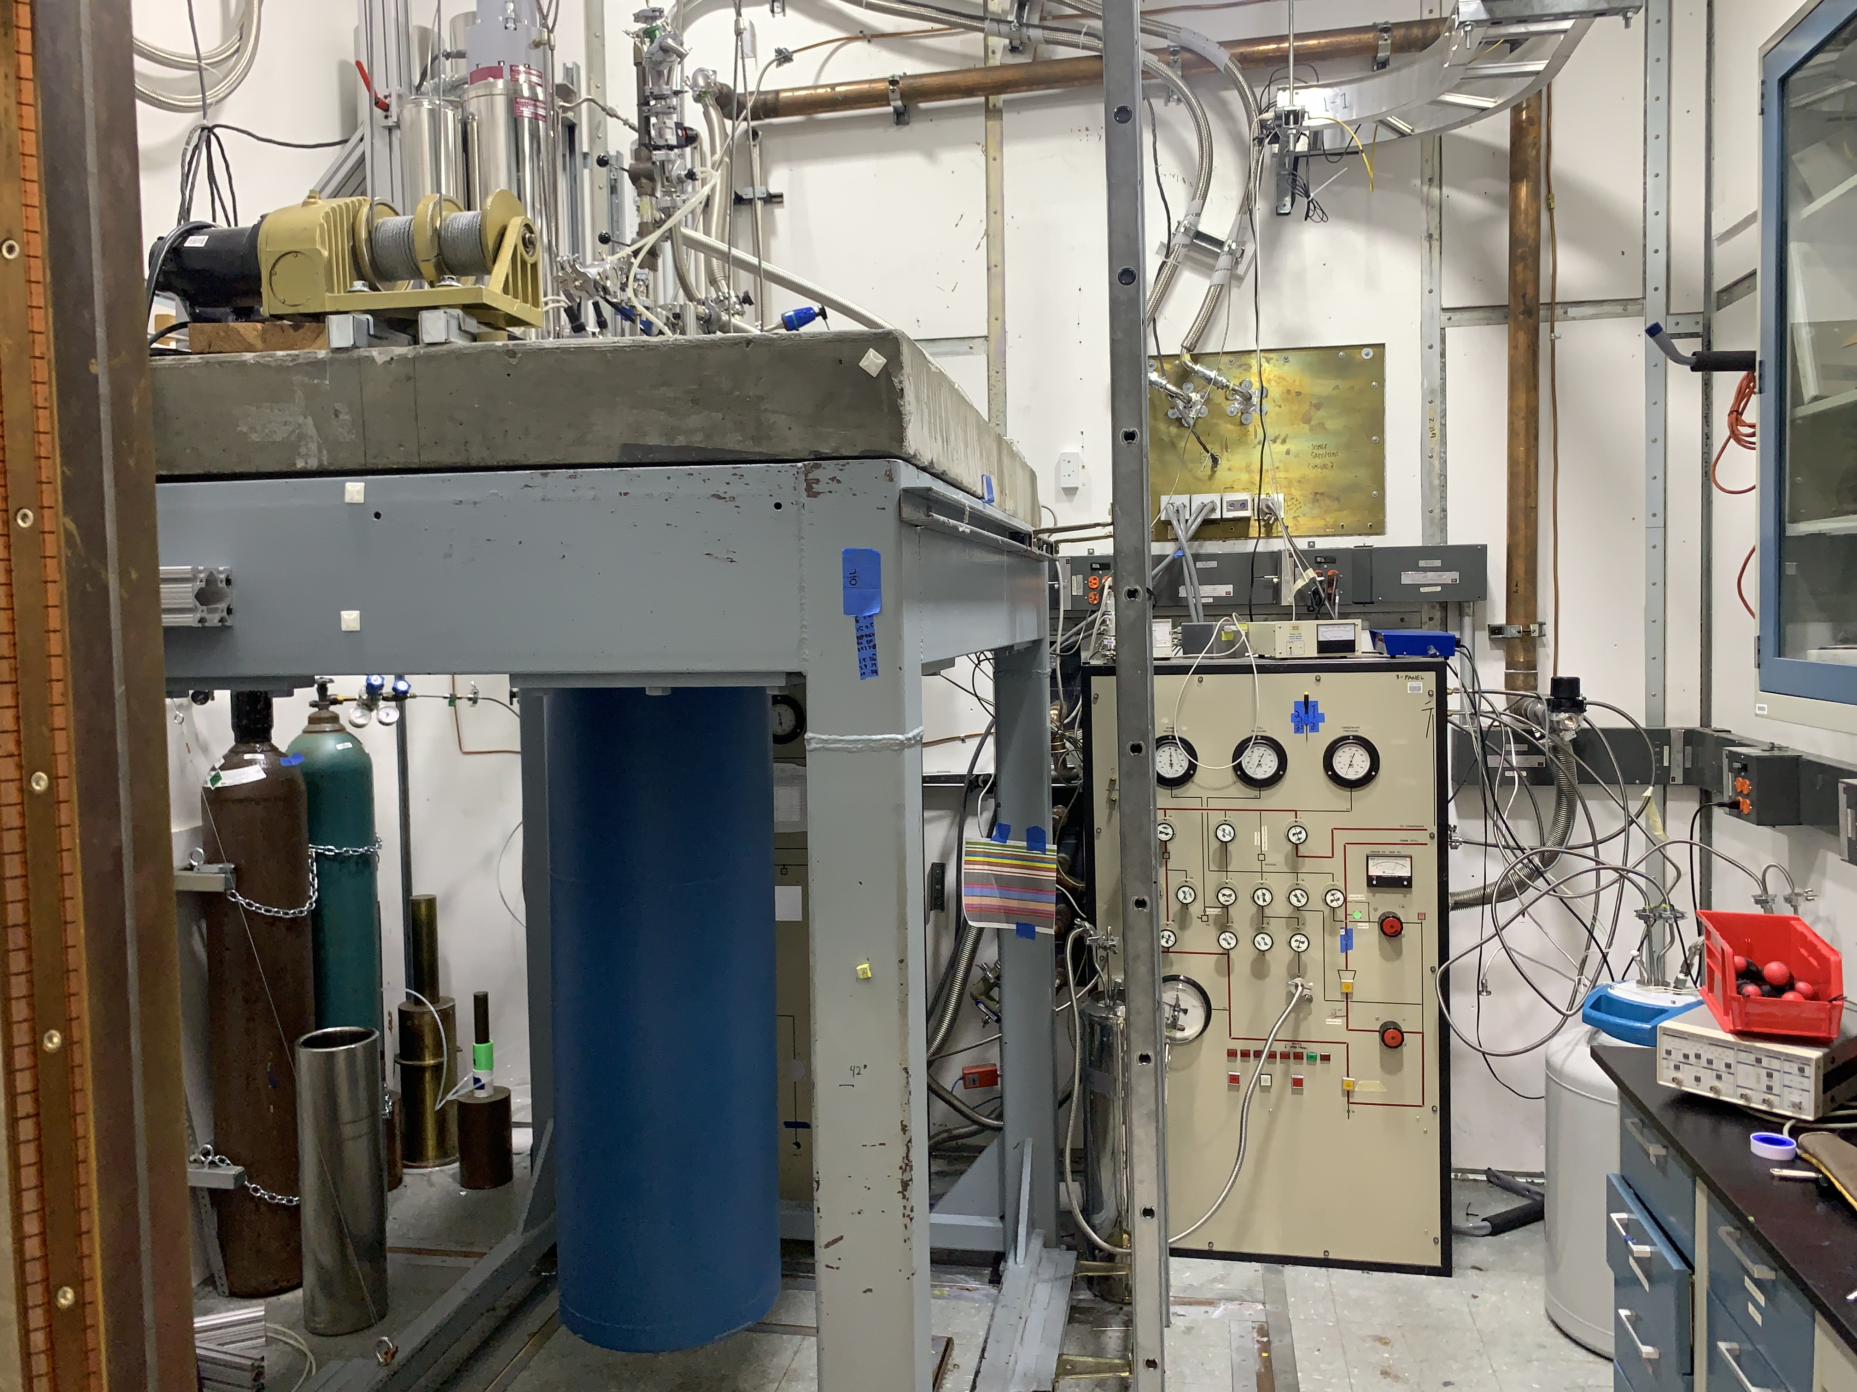
Caveat… This SUCKS (but not for you)
Must be near 0 K to prevent random thermal kicks to bad states (thermal noise is very big on a spin system and effectively makes your nice Hamiltonian gross)
(Me in my annealing past)

Slide 10

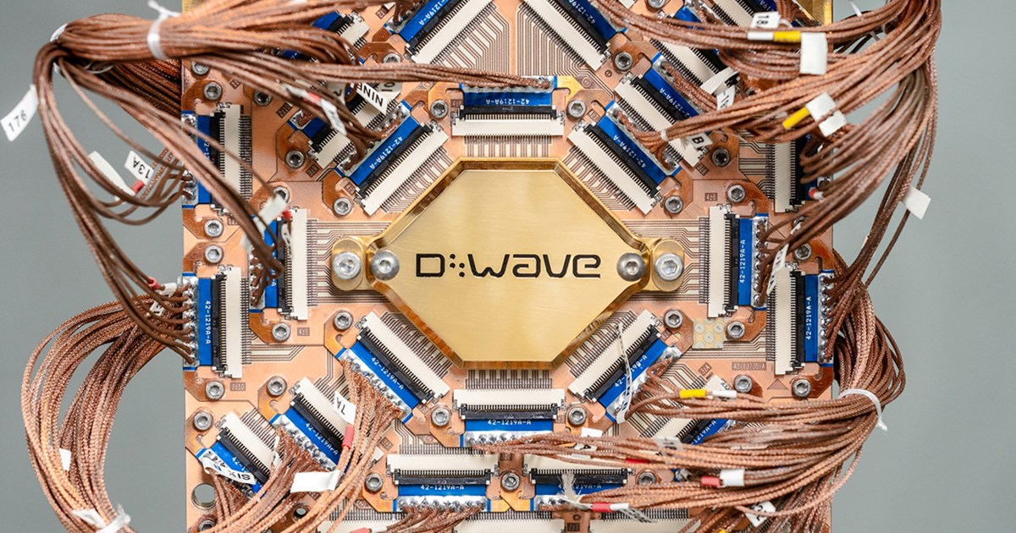
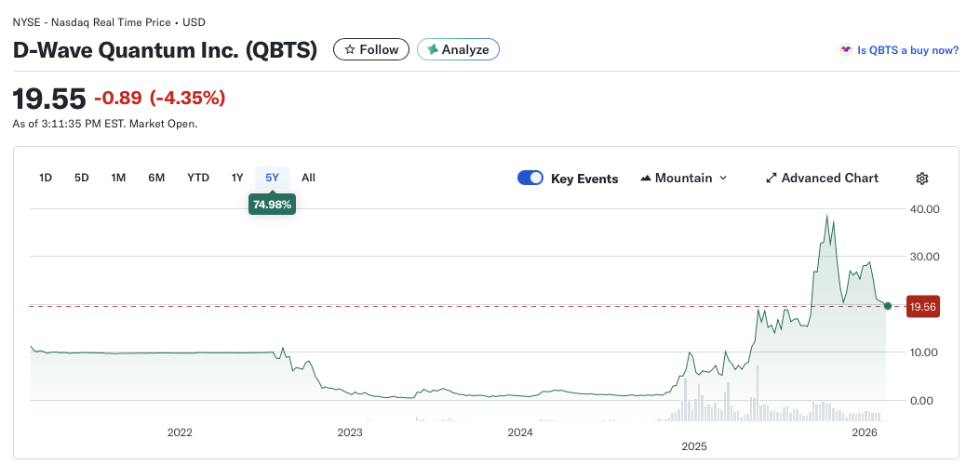
DWAVE
Have a hard problem? DWave will do the annealing for you ($$) and they can even do the math to convert it to a B-Field Hamiltonian ($$$$). “The boring Quantum Computing Company” – not really computing.

Slide 11
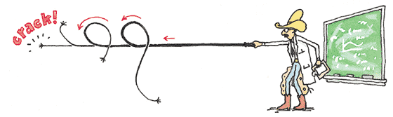
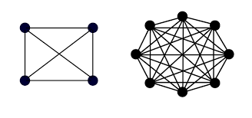
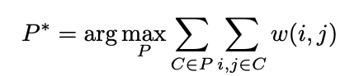
“Back to Satellites” (Dan )
SpaceX, Kuiper, ViaSat, etc. want LEO constellations. Data traverse satellite network so communication links must be optimized. Turns out to reduce latency, satellites must be grouped into communication “clusters” because listening to all the satellites is costly. What is the optimal partition?
LEO Constellation problem: Create graph G(V, E, w): V – Satellites as Vertices
E – Communication links as edges
w – Weights for each edge (how good are comms)
(depends on latency, reliability, and operational overhead)
+
NP Hard Problem – Exponential Time Classically (8hrs classically vs seconds on Dwave computer)

Slide 12
Intuitive Pictures
A
w(A,B) = 10
B
w(A,C) = 10
w(A,C) = -50
C
Caveat: Why can’t you just cut the negative edges? Because satellites need to be clustered – literally not possible from a hardware perspective for a starlink satellite to communicate with all 7000 starlinks. Latency, maintenance, computational memory explode.
Partitioning Problem:
V({A,B,C}) = 10+10-50 = -30
V({A,B},{C}) = V({A,B}) + V({C}) = 10 (Optimal)

Slide 13
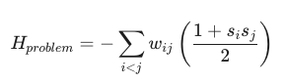
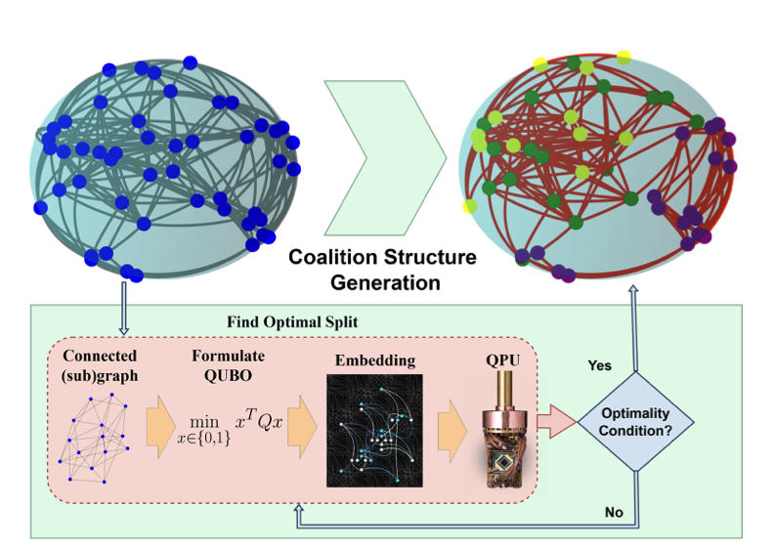
QUBO Reformulation
Reformulate as Quadratic Unconstrained Binary Optimization (QUBO) problem.
QCS-G
Where s_i = -1 (1) for group A (B).
QCS-G:
Start with 1 partition. Find optimal splitting (QUBO problems)
Iterate by splitting the smaller groups (only if utility is higher)

Slide 14
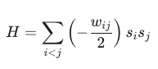
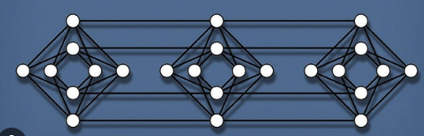
Getting onto a Quantum Computer
QUBO: easily expressed as quantum spins.
Since Dwave qubits are kind of sparsely connected, do a minor embedding (behind the scenes done for you).
(Computer converts weights to currents controlling Josephson Junctions between superconducting qubits.)
Ignoring constant offset:
A
B
C

Slide 15
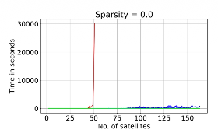
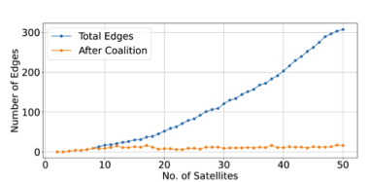
Results
In a few seconds the quantum computer finds the same solution the Gurobi (classical) solver finds in 8 hours.
* The quantum algorithm complexity is essentially independent of the number of satellites in the optimization while the classical algorithm is exponential. NEED to use quantum computer for constellations with thousands of LEO satellites. (Edges are expensive)

Slide 16

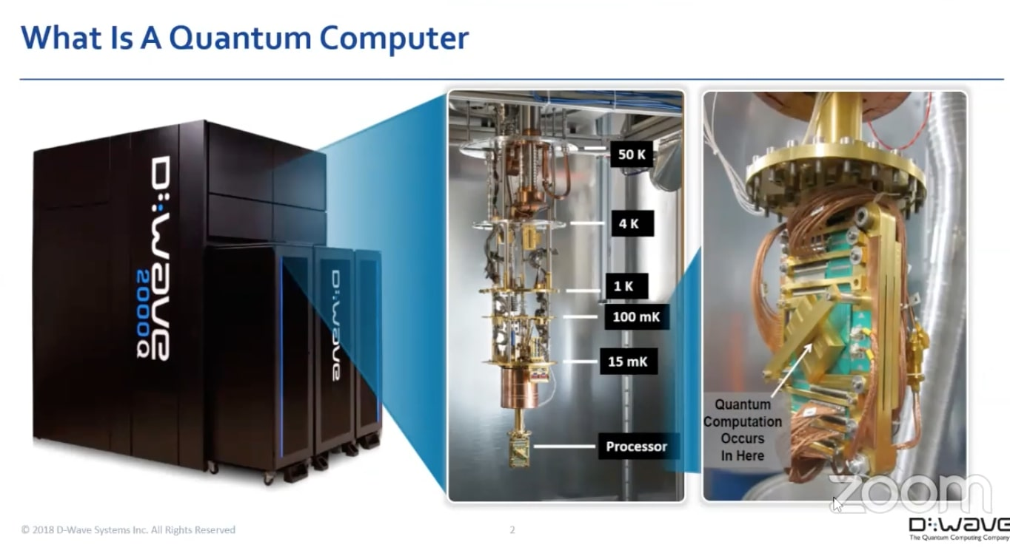
Your problem on a Quantum Annealer
1. Discretize it: Can your problem be written as a sequence of discrete possibilities. (ex. Constellation task planning, routing, onboard sensors, etc.).
2. Formulate as weighted, non-directed graph problem. (i.e. which edges are good)
→ Quantum Computer is good if your problem looks like a graph and is a combinatorial nightmare.

Slide 17
Thank you!
Reference: Quantum Annealing-Based Algorithm for Efficient Coalition Formation Among LEO Satellites, Venkatesh, Supreeth and others (2024)

